Slide 1
CSCI 164 Project
Alexander Madrigal and Nathaniel Madrigal

Slide 2
Student Performance
Regression
K-neighbors regressor
Elastic net
13 numerical features (Standard Scaler)
17 categorical features (One Hot Encoder)
3 numerical output features (1 used)
Score from 0-20

Slide 3
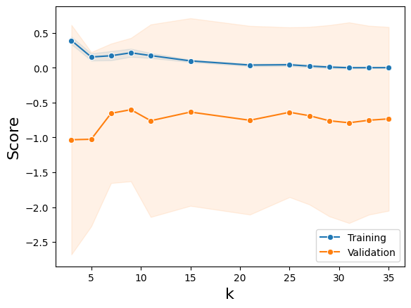
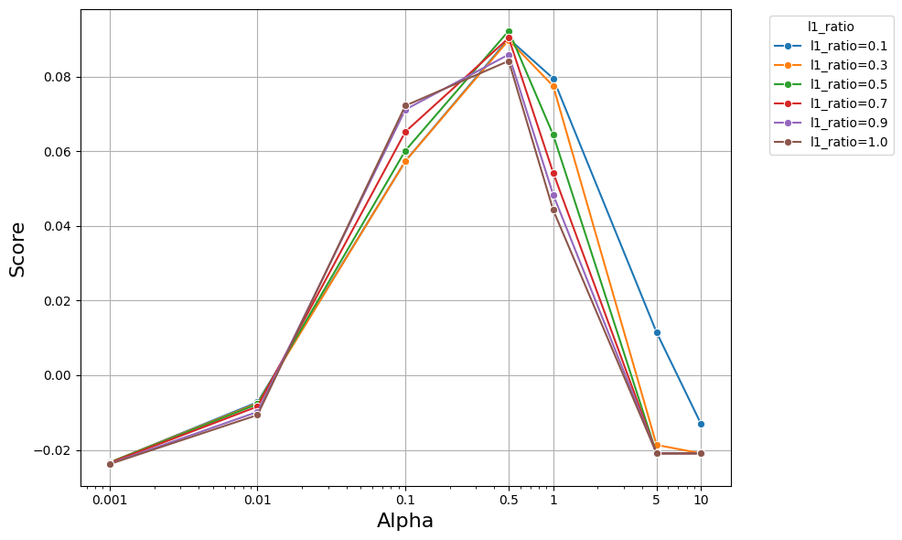
Verification: Hyper Parameter Tuning
K=15
Alpha=0.5
L1-ratio=0.5

Slide 4
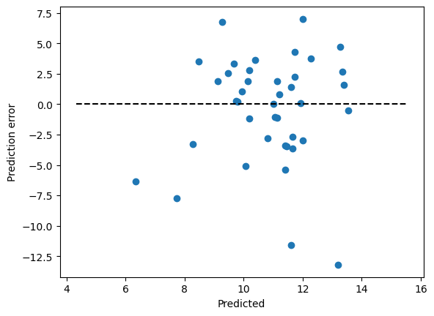
Predication Error
KNN
MAE: 3.343, MSE: 19.204, RMSE: 4.382 R-squared: 0.139
ENet
MAE: 3.209,MSE: 17.498, RMSE: 4.183, R-squared: 0.215

Slide 5
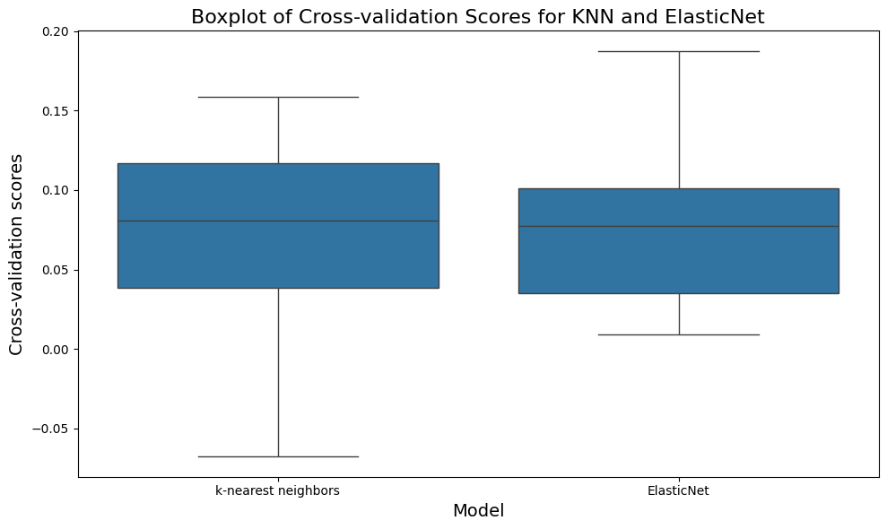
Cross-validation scores

Slide 6
Letter Classification
K Nearest Neighbors Classification
Gaussian Naive Bayes
Quadratic Discriminant Analysis
16 numerical features (Standard Scaler)
1 Categorical output feature
1 of 26 capital English letters

Slide 7
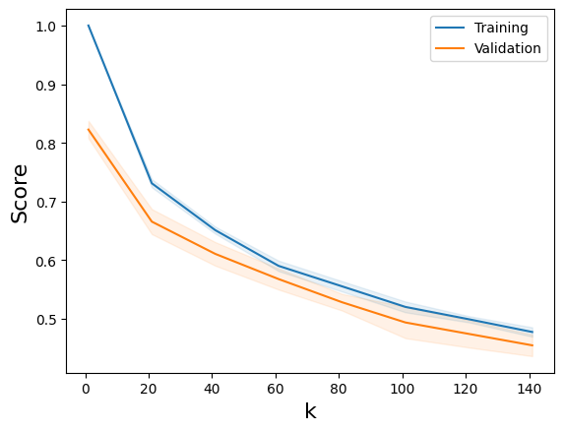
Verification: Hyperparameter Tuning
K = 1
Strongly clustered data
Potential overfitting

Slide 8
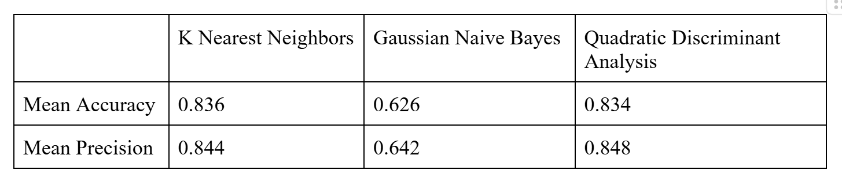
Classification Model Metrics
Cross validation
Accuracy and Precision scores

Slide 9
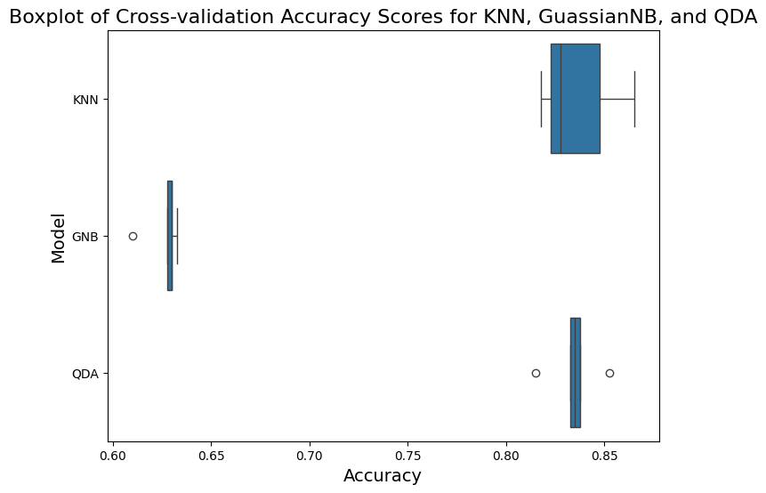
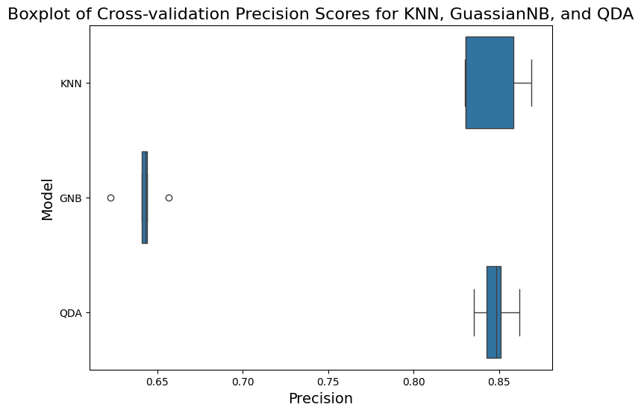
Classification Model Metrics: Boxplot Analysis
KNN has lower median and higher IQR than QDA
QDA is best classification model for dataset

Slide 10
Thank You

